Slide 1


Updates from the World Meteorological Organization
Oksana Tarasova
WMO Science and Innovation Department

Slide 2
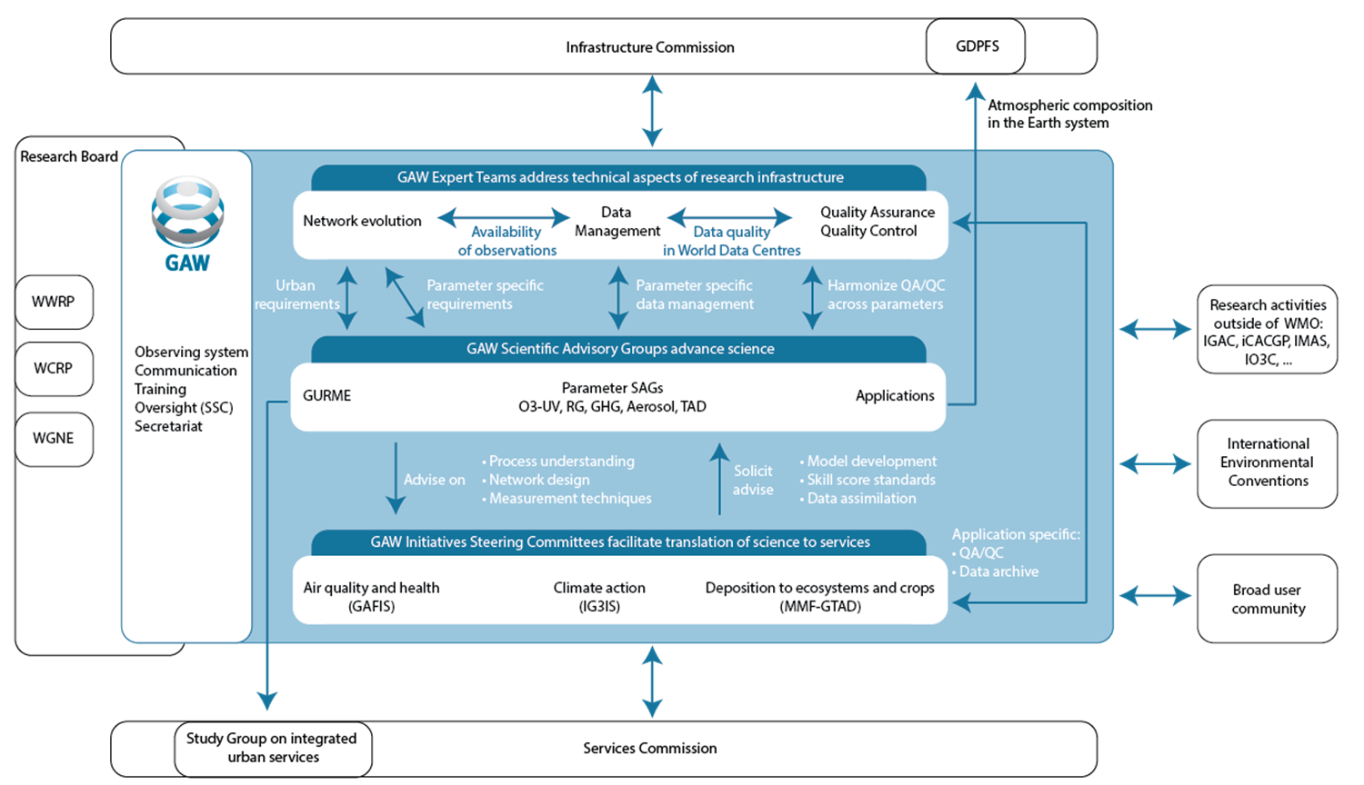
Internal organization of GAW
Modified organization and ToRs finalized Dec. 2020

Slide 3
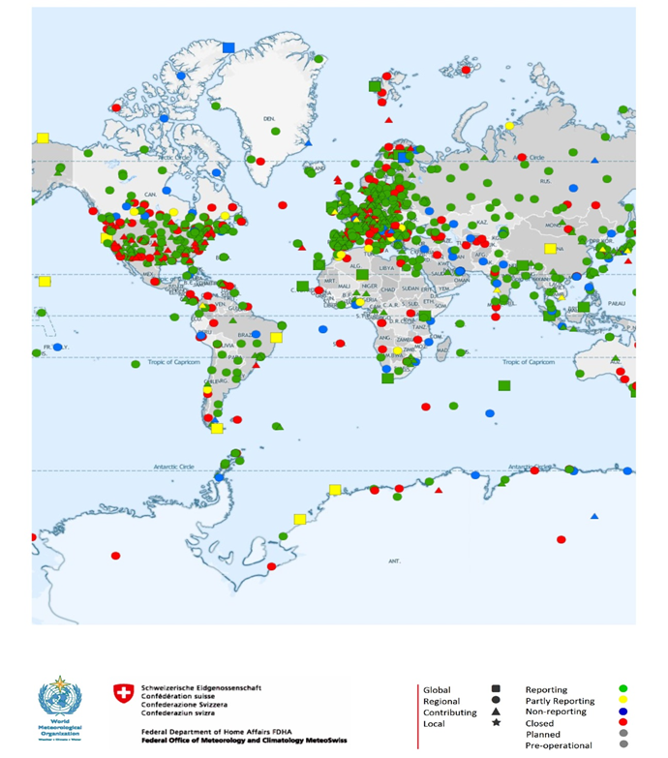
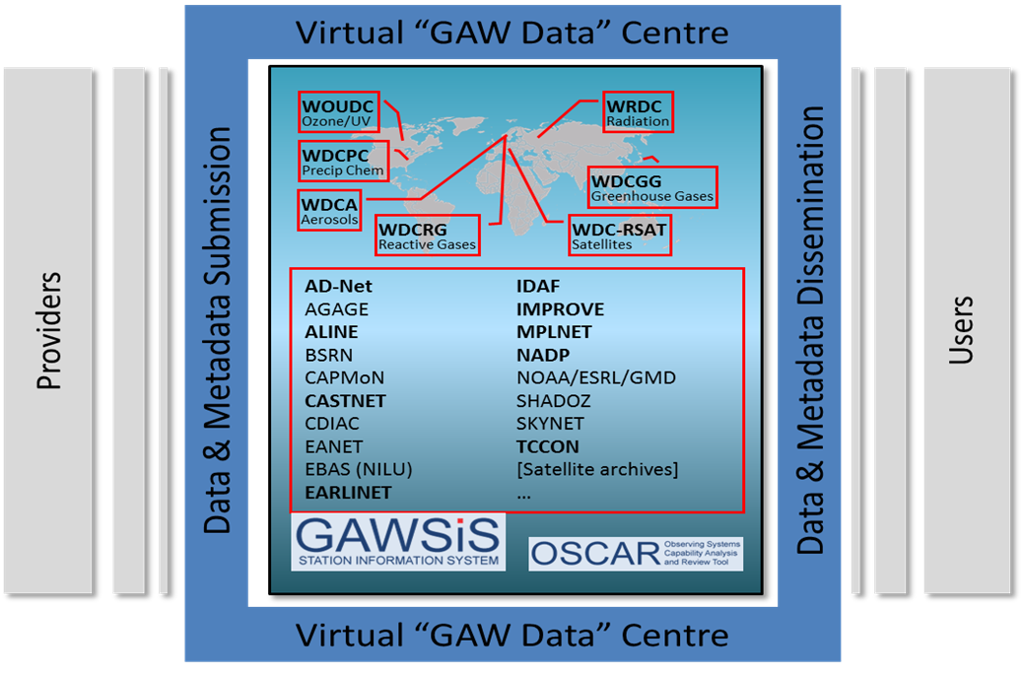
Research Infrastructure in GAW
Expert Team on Atmospheric Composition Network Evolution: collects requirements related to atmospheric composition observations and advise on the network evolution (within last/this year worked on harmonization of requirements with GCOS)
Expert Team on Atmospheric Composition Measurement Quality: develops common approaches and tools for QA/QC across thematic groups in GAW, including measurement traceability and uncertainty. It had its first meeting (virtual) from 24 to 29 September 2020
Expert Team on Atmospheric Composition Data Management: works on enhancing data management architectures to facilitate improved metadata exchange and interoperability, data discovery and analysis (worked on the implementation of WIGOS metadata standard in GAW)
Notes:
Updated statement on the low cost sensors to be delivered by December 2020

Slide 4
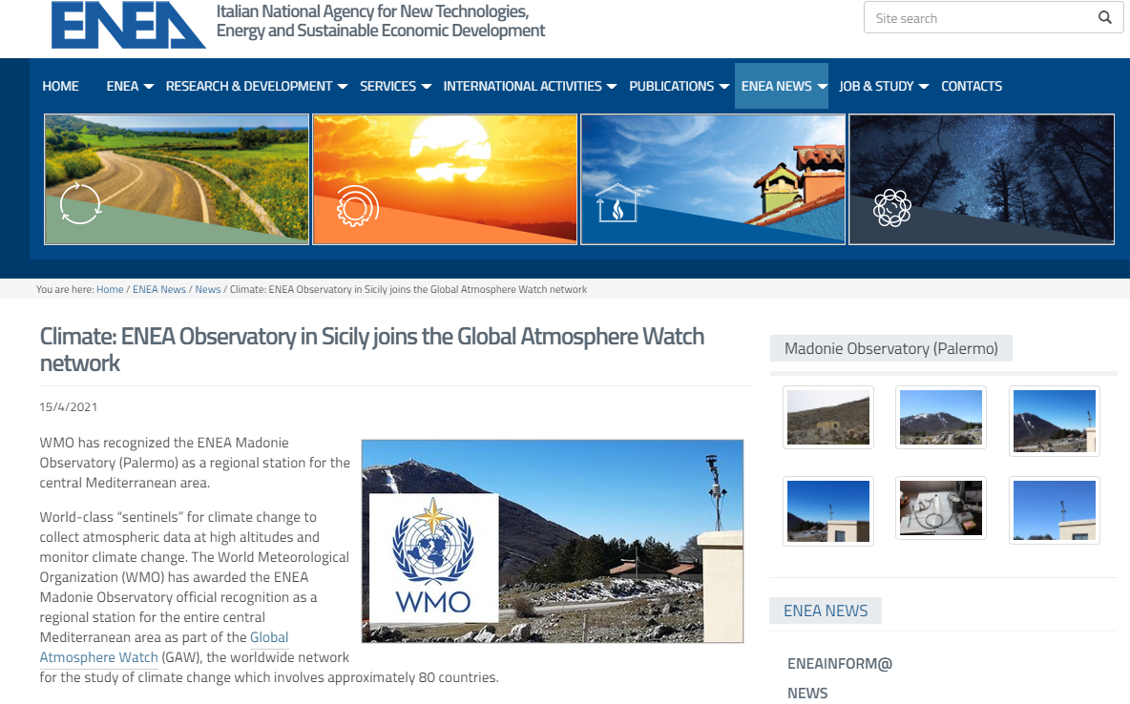


New regional stations accepted in GAW
Helgoland station, Germany
Madonie – Piano Battaglia station, Italy
Cholpon-Ata station, Kyrgyzstan

Slide 5

Update of the statement on the low-cost sensors
(i) LCS continue a trajectory of rapid growth and are likely to continue to do so.
(ii) These devices are not yet suitable for replacing reference monitoring networks.
(iii) LCS should be operated under a protocol of rigorous quality assurance and quality control that meets or exceeds the objectives of the research application.
(iv) Almost all LCS have known and still-unknown issues that affect their precision and accuracy. These include sensors cross-sensitivity to the compounds that are not intended for measurements, effects induced by temperature and humidity, varied response times, and drifting baselines.
(v) Community engagement and outreach, and the use of LCS in educational contexts, are a particular strength of these devices.
(vi) LCS represent a logical tool to assess air quality in regions of the world that lack high quality atmospheric composition observations, and which are also understudied. But it is important to support these methods with appropriate calibration and validation platforms to ensure high quality data.
Includes sections on LCS network cost estimate!
Launched in February 2021
Notes:
Updated statement on the low cost sensors to be delivered by December 2020

Slide 6












Approach to WMO Unified Data Policy
Single, unified data policy
  Earth Systems approach, centred around support for & delivery of global NWP
Maintain policy and practice structural elements of Res 40
  Free and unrestricted international exchange “of Earth-system data”
  Core and Recommended exchange requirements specified in Annex 1 for all (7) WMO-relevant domains/disciplines
  Data inclusively defined – observed, analysed, predicted, products
Implementation and compliance monitoring
  Absent in existing policies
  Codify, update, enhance via Technical Regulations
  Monitor and address non-compliance
    including through capacity development
Periodic, consultative review of practice aspects
  Ensure policy remains fit-for-purpose
  Based on changing demand, user need, data options
  Review specification of data types as warranted
    Introduce new ‘emerging’ data types
Will go to WMO Congress in October 2021
Notes:
Does not just replace the three existing data policies, but embraces the entire Earth system within a single data policy.
The scope of the Earth system data covered by the policy is defined in Annexes 1 & 4.
Further, Annexes 2 &3 provide guidance to help WMO Members maximize the benefit obtained from the free and unrestricted exchange of Earth system data; and, in the spirit of the Geneva Declaration, optimise the value of data exchange across the public, private and research sectors.
The policy and practice structure of Res 40 have provided a robust basis for the new policy, unlike Res 25 and 60 which are non-binding in nature.
The policy includes a clarified and literal interpretation of Free and unrestricted, which means available for any use, re-use and sharing without charge and with no conditions on use.
And in the spirit of both improving clarity and removing ambiguity, ‘essential’ has been replaced by ‘core’ and ‘additional’ by ‘recommended’ – this is more aligned and consistent with the meaning of ‘shall’ and ‘should’ in common WMO usage. In the time since Res 40, ‘essential’ has taken on a difference nuance with GCOS/GOOS use of the word in their ECV/EOV’s. Hence, it was felt we need to be more explicit in Res 42.
The policy also makes it clear that ‘data’ has a very inclusive meaning – observations, analyses, predictions, derived information, data sets, modelling products – and that all are exchanged as prescribed in Annex 1.
Implementation and compliance monitoring are important features of Res 42, and make use of the tried and true WMO mechanism of Congress-approved technical regulations to ensure the expectations on Members are clearly codified.
Timely data exchange is of course key to timely NWP outputs; but it’s about more than timeliness - unless the observations are exchanged, they won’t do anyone much good.
Compliance monitoring is a key implementation tool, which was sorely missing in the prior policies. Compliance monitoring ensures visibility of exchanged data, in all its wide embrace, and will help in raising awareness and directing assistance where there are gaps.
WMO data policy must be evolving and flexible in its practice, encompassing more and new data (e.g., new platforms, changing user needs, requirements for impact data, to capitalise on developments in NWP etc ), as needed to support and grow the WMO mission and vision, and to support Members in their missions at a national level.

Slide 7
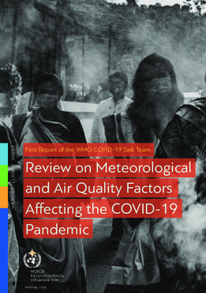
Priorities for 2021 and the Research Board workplan
  Extension of Task Team Exascale computing/AIs with new focus (until Cg, October 2021)
  Continuation of Task Team SARS-CoV-2/COVID-19/Meteorological and Air Quality Factors (until Cg, October 2021)
  RB help to identify synergies and support to the 3 programs (ongoing)
  Contribute to hydrology Research Strategy to improve the delivery of hydrologic information & services and build partnership across WMO, UNESCO and community
  Improve collaboration with Technical Commission and Regional Associations
  Strengthen capacity building and education with focus on Early Career Scientists
  Planning for Open Science Conference on the Earth System in close collaboration across WMO, ISC, UNESCO (IOC), SAP and the private sector
Launched in March 2021

Slide 8
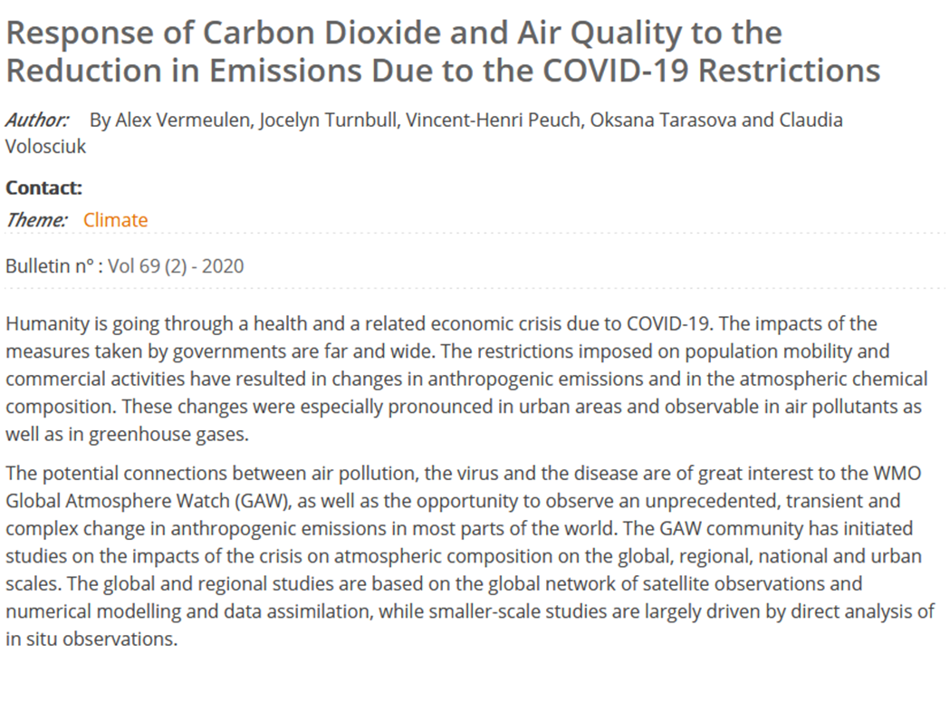

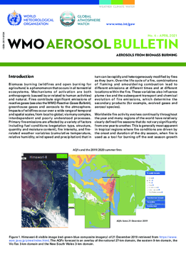
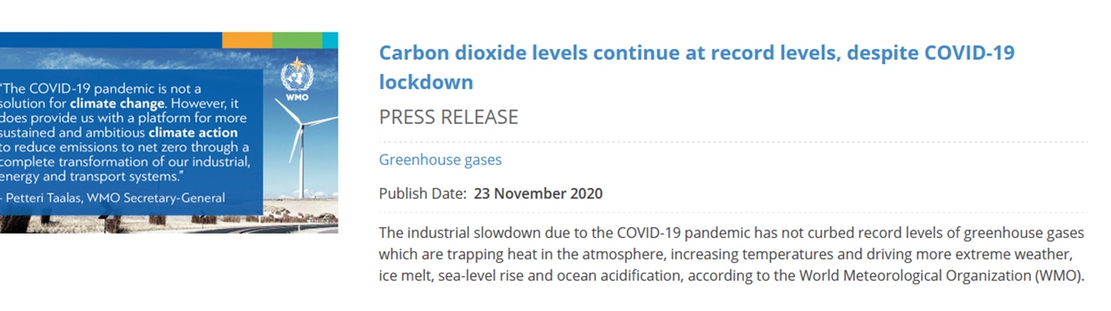
GAW coordinated efforts on COVID
  “A global observational analysis to understand changes in air quality during exceptionally low anthropogenic emission conditions” lead by Ranjeet Sokhi (submitted): includes 63 cities from 25 countries, PM2.5 , PM10 , PMC (coarse fraction of PM), NO₂ , SO₂ , NOx, CO, O₃
  “Air Quality and Climate Bulletin” will be launched with the first issue describing impact of COVID on air quality
  Overview paper on “Lessons learned in atmospheric chemistry from COVID” is in preparation

Slide 9

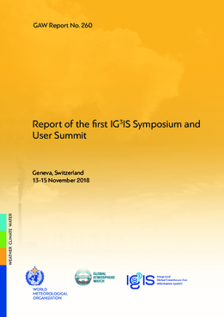



Integrated Global Greenhouse Gas
Information System (IG³IS) is
The report of the first Symposium is produces
Presented at the Earth Information Day in November 2020
Three stakeholder consultations organized (urban, industrial methane and LULUCF)
Urban GHG emissions good practice are nearly finalized
Notes:
Recognized by SBSTA in June 2019 and included in the IPCC TFI Guidebook refinement. The main task of the new SC to go for upscale

Slide 10

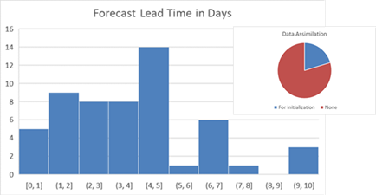
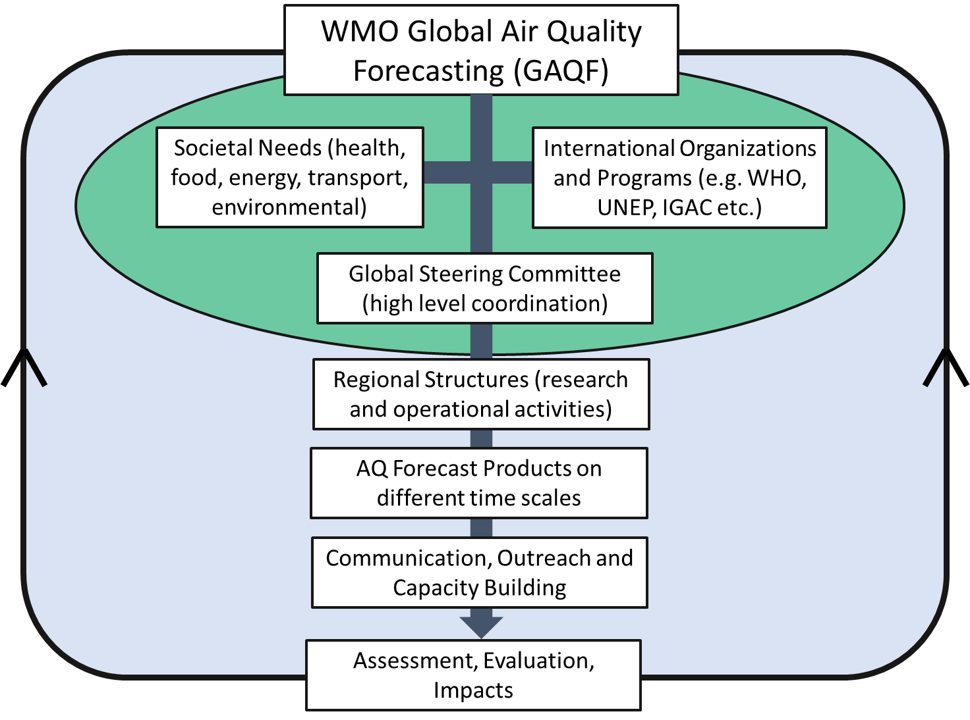
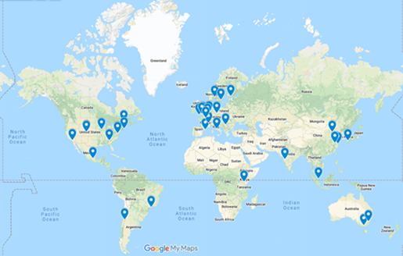
Global Air Quality Forecasting and Information system (GAFIS)
Performed a survey of the available AQ forecasting systems
Supported development of the Training Materials and Best Practices for Chemical Weather/Air
Works on the development of the Implementation plan (looking for consultancy)

Slide 11
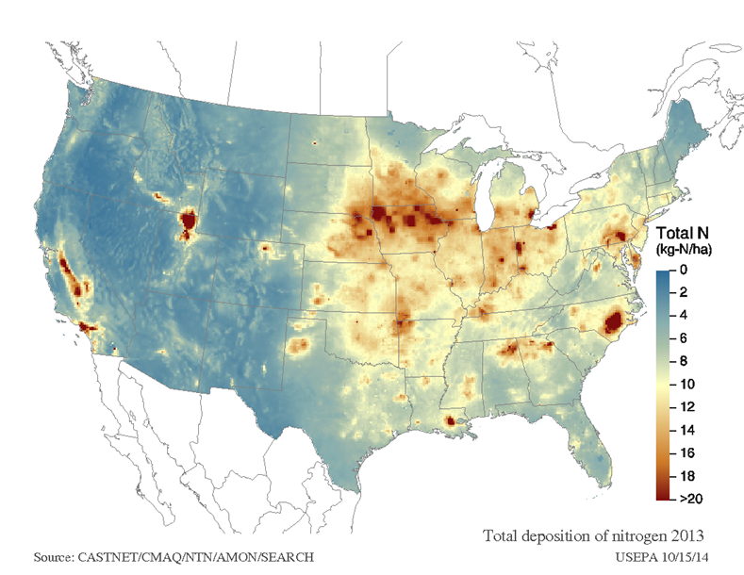
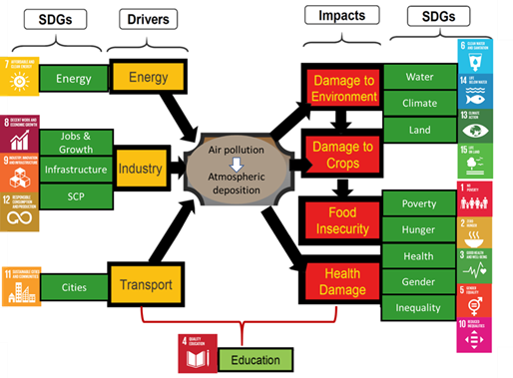
Measurement-Model Fusion for Global Total Atmospheric Deposition
MMF brings together best-available data and modelling results on precipitation chemistry, precipitation depth, air concentrations and dry deposition velocities to estimate wet, dry and total deposition
The Implementation plan is developed
Next steps:
Data harvesting exercise for the 2010 system (supported by NILU)
User and stakeholder mapping and engagement (looking for consultancy)
Supporting animation is in the preparation

Slide 12

GAW Symposium 2021
This year's quadrennial GAW Symposium will happen online from
28 June to 2 July 11:30 am – 2:30 pm CEST
It will consist of the following sessions:
Science for services: The importance of atmospheric composition
Filling critical gaps in observations
Atmospheric composition, pandemics and support for a new health agenda
Earth system modelling and data management
Future of GAW and reflection on the Symposium
https://community.wmo.int/meetings/gaw-symposium-2021
ABSTRACT deadline is 15 May

Slide 13

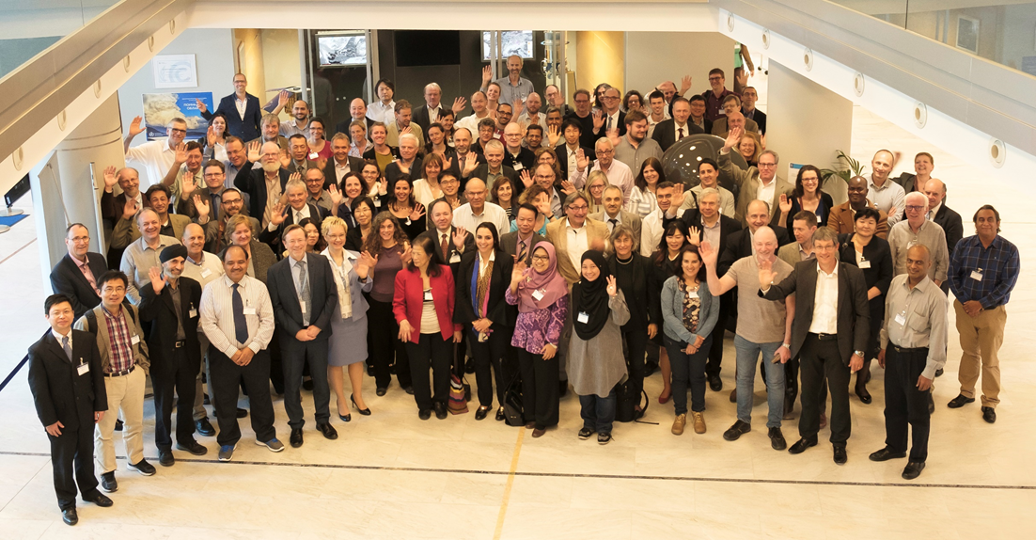

Thank you!
Merci!

